Slide 1

Waste Management System

Slide 2
Introduction
What is Waste Management?
Waste management involves the collection, treatment, and disposal of waste materials to minimize environmental and health hazards.
How Machine Learning Helps:
Automates waste classification (e.g., organic vs non-organic).
Optimizes resource allocation and reduces costs.
Provides predictive insights for better waste management plan

Slide 3
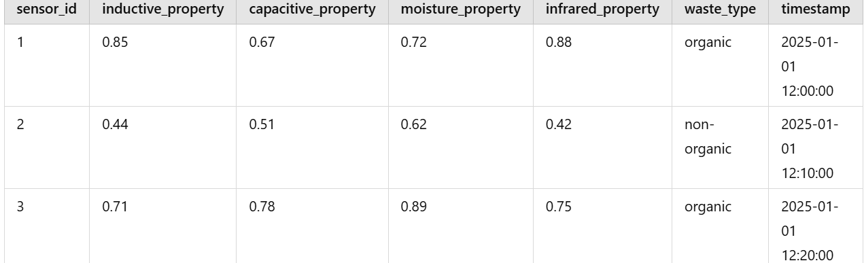
Dataset Overview
Dataset Description : Sensor data: inductive, capacitive, moisture, infrared properties
Labels: Waste type (organic/non-organic)

Slide 4
Data Preprocessing
Handling Missing Values:
Used imputation techniques to fill missing data or removed rows with excessive null values.
Removing Irrelevant Columns:
Dropped columns like sensor_id and timestamp that are not relevant for waste classification.
Converting Categorical Data to Numerical:
Converted waste_type (organic/non-organic) into a binary column is_organic (1 for organic, 0 for non-organic).

Slide 5
Exploratory Data Analysis (EDA)
Scatter Plots:
Relationship between inductive_property and infrared_property, color-coded by waste_type.
Reveals how waste types are distributed based on sensor properties.
Heatmap:
Correlation matrix of sensor data (moisture, infrared, inductive, and capacitive properties).
Highlights strong or weak relationships between variables, aiding feature selection.

Slide 6
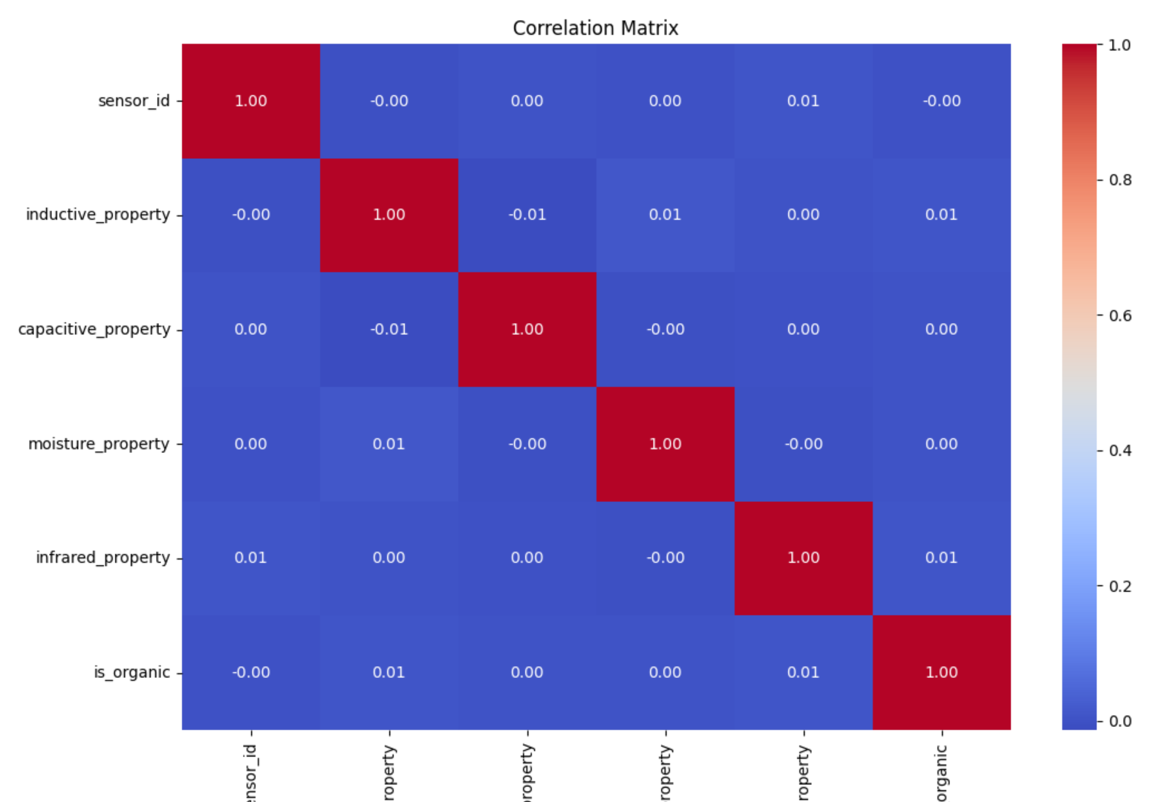
Correlation Matrix:

Slide 7
Balancing the Dataset
What is oversampling?
Replicating samples of the minority class to balance the dataset.
Ensures the model has enough data to learn patterns for both classes.
Method Used:
Resampling: Duplicated organic waste samples to match the count of non-organic samples.
Performed using Python’s resample function from sklearn

Slide 8
Machine Learning Workflow
Data Preparation:
Cleaned data, handled missing values, and converted waste type into numerical format (is_organic).
Dropped irrelevant columns to focus on sensor properties.
Train-Test Split:
Divided data into 80% training and 20% testing sets.
Ensures that the model is evaluated on unseen data for accurate performance assessment.
Feature Scaling:
Standardized numeric features (e.g., inductive, infrared properties) to ensure uniform scales for all variables

Slide 9
Model Training:
Algorithm Used: Random Forest Classifier.
Ensemble technique that builds multiple decision trees and combines them for better predictions.
Evaluation:
Used metrics like accuracy and classification report (precision, recall, F1-score) to measure model performance.

Slide 10
Model Training and Tuning
Random Forest Training:
Random Forest Classifier is an ensemble learning method that combines multiple decision trees to improve prediction accuracy and reduce overfitting.
Why Random Forest?
Feature Importance in Random Forest is a key strength. It helps determine which variables (features) are most relevant in predicting the target class.
Relevance to Waste Classification:
Purpose: Identifying which sensor properties (e.g., inductive, capacitive, moisture, infrared) most impact the classification of organic vs non-organic waste.

Slide 11
Hyperparameters Tuned Using GridSearchCV:
Hyperparameters are the settings that define the model's behavior and performance.
Key hyperparameters for Random Forest:
n_estimators: The number of trees in the forest.
max_depth: Maximum depth of each tree.
min_samples_split: Minimum number of samples required to split an internal node.
min_samples_leaf: Minimum number of samples required to be at a leaf node.
GridSearchCV performs an exhaustive search over a specified parameter grid, testing all possible combinations to find the best-performing set of hyperparameters.

Slide 12
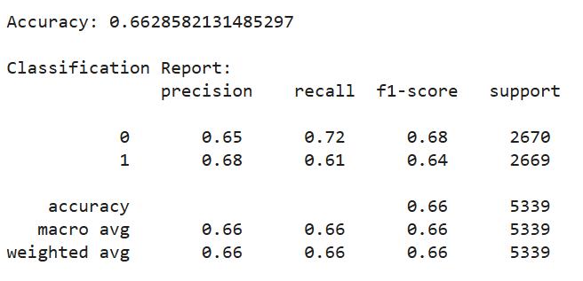
Before Tuning

Slide 13
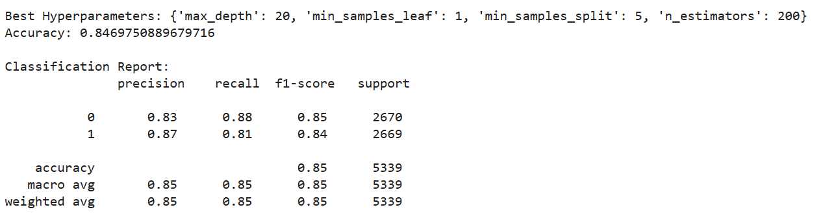
After Tuning

